Slide 1
Green Roots Community Garden Propposal
GREENROOTS
Cultivate Sustainable Communities Through Urban Agriculture
Greenroots.org.za | August 2026

Slide 2
Who We Are
2018
Founded with 1 school garden
2020
Expanded to 12 schools that launched volunteer programs
2022
Planted 5,200th tree and introduced Green Leaders
2024
Reached 12,000 students and secured corporate partnerships
2026
47 Gardens,12,500 students,3,200 volunteers
Registered non-profit Organisation(NPO)since 2018
Mission:Transform school spaces into vibrant gardens that serve to empower students to engage with sustainability through practical ,hands-on learning
We plant trees, run workshops and to develop the next generation of green leaders

Slide 3
12,500
STUDENTS REACHED
Green Roots serves to transform underutilized school spaces into vibrant educational Gardens across the Western Cape
Since 2018:47 school gardens were established ,12,500+students reached ,8,900+ trees planted,3,200+ active volunteers
By addressing food insecurity,environmental education and community cohesdion through hands-on urban agriculture
This proposal serves to outline our stategic plan in order to expand digital presence,volunteer recruitment and funding capacity
8,900+
TREES PLANTED
3,200+
ACTIVE VOLUNTEERS

Slide 4
What we Do:
School Garden Programme -47 active school gardens with raised beds,composting and rainwater harvesting -Curriculum-aligned lectures for Grades R-7 -Termly harvest celebrations whilst involving parents | Community Workshops -Free monthly sessions, Composting,container gardening,seed saving -Open to all residents,builds informal grower networks | Urban Reforestation -2,200+ indiginous trees which have been planted since 2018 -Micro-forest restoration within degraded public spaces -Community planting days every quarter | Green Leaders -6-month intensive for the youth aged 16-19 -combines agriculture training with leadership and project management -100% placement rule in further study or green economy employment

Slide 5
Where we are Online
STRENGTHS Domain name greenroots .org.za is memorable and brand appropriate Basic contact information and location details are accessible Mobile responsive template | WEAKNESSES Donations are non-functional requiring donors to email or visit in person Poor information hierarchy, the site mayy prove to difficult to go through and understand what we do and how we help No event calendar- volunteer opportunitites are posted only on Facebook

Slide 6
Show Donors Exactly What Their money Does
R50 Compost and mulch for one garden bed for a month | R100 Seeds as well as seedlings for an entire school garden classroom | R200 Seeds for one garden bed and workshop materials for 5 students
R500 Full-day hands-on gardening workshop for 15 residents | R1,000 New vertical garden at an under-resourced schools | R2,000 One month of the youth Green Leadership

Slide 7
Who We Serve &
Who Serves With Us
PRIMARY-Local Residents 25-55
Interested in gardening ,sustainability and community volunteering
Primary volunteer base and workshop participants
Value: skill-building,social connection
Secondary-Local Schools
Seeking educational field trip destinations and support
Life science teachers and parent bodies
Value:CAPS-aligned outdoor learning student engagement
Tertiary-Corporate sponsors& grant bodies
Evaluating social impact for ESG reporting and funding allocation
Value: Measurable outcomes ,brand alignment

Slide 8
From Proposal to Launch
DIscovery DESIGN DEVELOPMENT Launch & Growth
Month 1 Month2 Month 3 Month 4
Stakeholder interviews ,auditing Wireframes and visual designs CMS intergration and Content migration,SEO
Content, competitor analysis UX Prototyping payment gateway setup Optimisation,staff training
Deliverable: Creative brief and sitemap Deliverable :Figma prototype for board Deliverable :staging site Deliverable:Live site +90 day
Approval with full functionality marketing sprint
PHASE1
PHASE 2
PHASE 3
PHASE 4

Slide 9
Lets grow Together
Volunteer -Join 2,300+ community members making in making difference | Donate Every rand helps to plant a seed and support the next school garden | Partner Schools as well as corporate:lets build something lasting
Email
Hello@greenroots.org.za
Visit
Greenroots.org.za
Visit

Slide 10

Our Vision for 2030
A city where each and every community has access to fresh, locally grown produce and clean water as well as a healthy waterfront-fostering neighbourhoods that serve as a support systems for cultural and economic diversity through shared green spaces
Every primary school Is our target to have a greener future for all, Growing disconnect between youth and naturals ecosystems with limited practical stability
Communities self organise around Urban Agriculture hubs ,fresh produce from garden suplements 50+feeding schemes

Slide 11

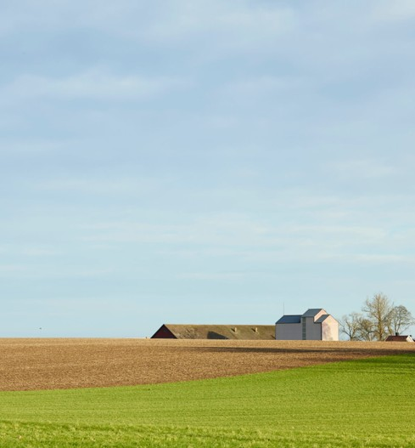
END OF PRESENTATION
THANK YOU.

Slide 12
The Challenges We Face

